Slide 1
Chapter 8
Regularization
The problem of overfitting

Slide 2
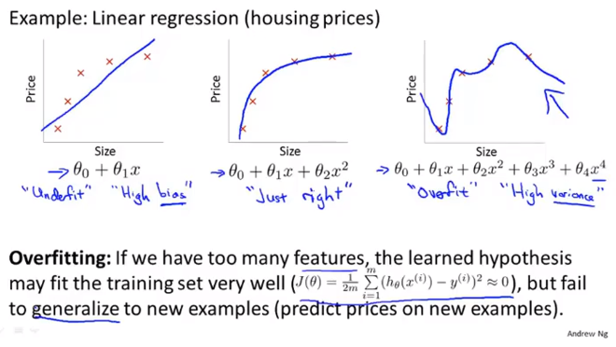
Chapter 8

Slide 3
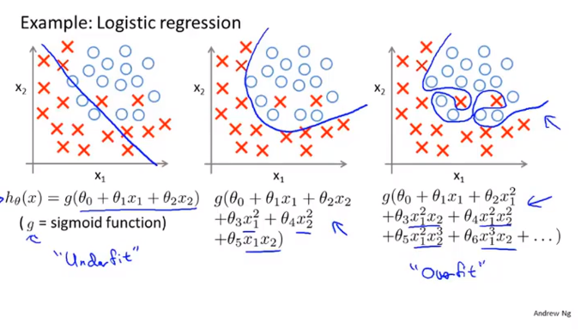
Chapter 8

Slide 4
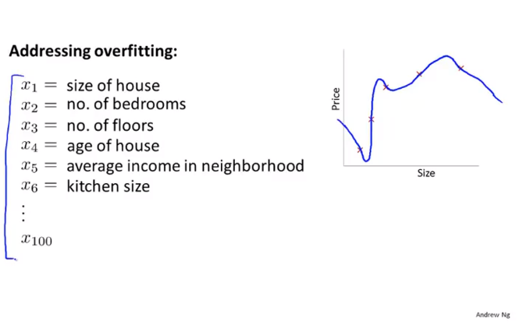
Chapter 8
I
If we have many features and a very little training data
Then overfitting can be a problem

Slide 5
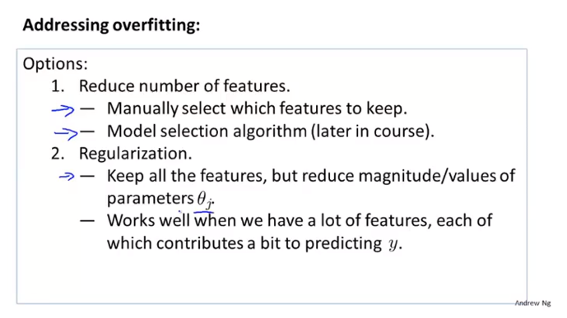
Chapter 8
Magnitude 量级
Vlaues 数值大小

Slide 6
Chapter 8
Regularization
Cost function

Slide 7
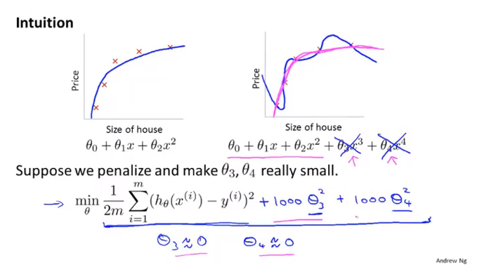
Chapter 8

Slide 8
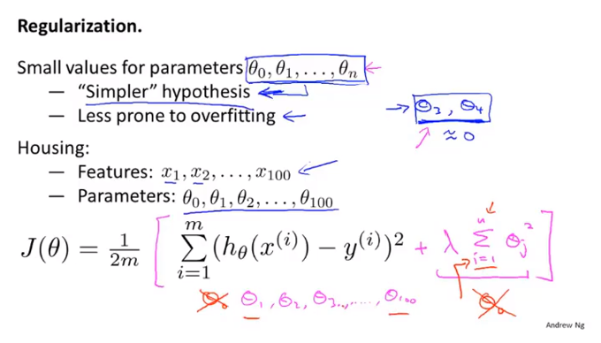
Chapter 8

Slide 9
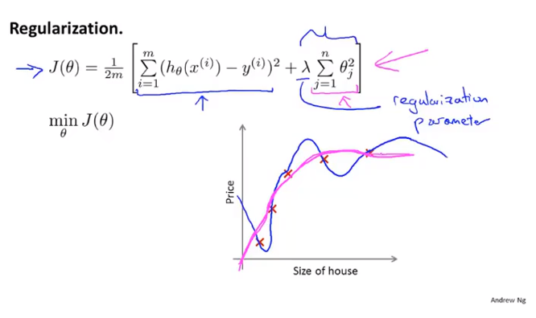
Chapter 8
The two term in J(theta) has two goals,.
left is to fit the training set while the right is to keep the parameters small
Lambda is to control the tradeoff between these two goals.
Therefore to keep the hypothesis relatively simple to avoid overfitting.

Slide 10
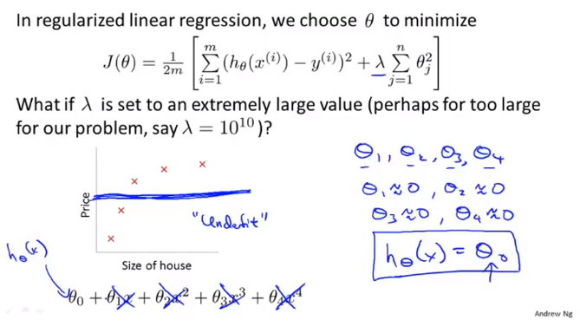
Chapter 8
The hypothesis this straight line has too strong a preconception or too high bias
Choose a good choice of lambda

Slide 11
Chapter 8
Regularization
Regularized linear regression

Slide 12
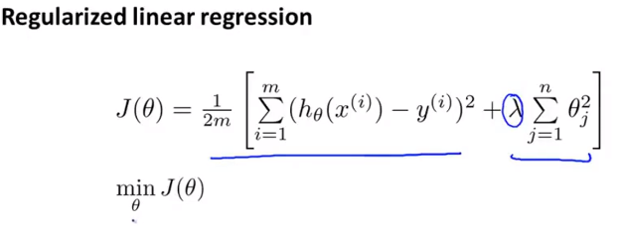
Chapter 8

Slide 13
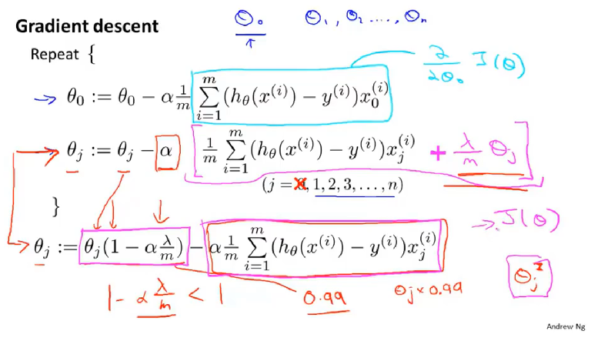
Chapter 8

Slide 14
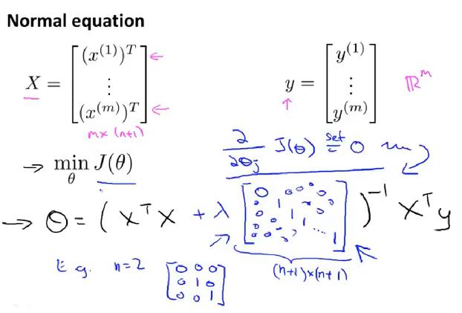
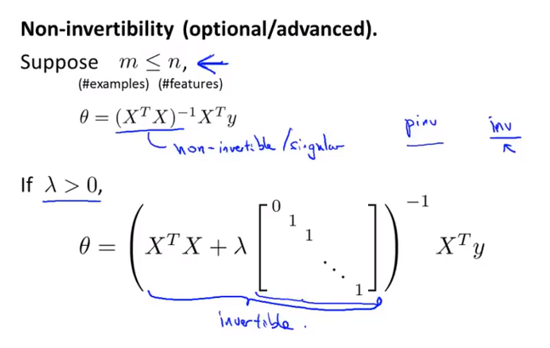
Chapter 8
Using regularization also takes care of any non-invertibility issues of the X transpose X matrix
Using this, you’ll be able to avoid overfitting even if you have lots of features in a relatively small training set.

Slide 15
Chapter 8
Regularization
Regularized logistic regression

Slide 16
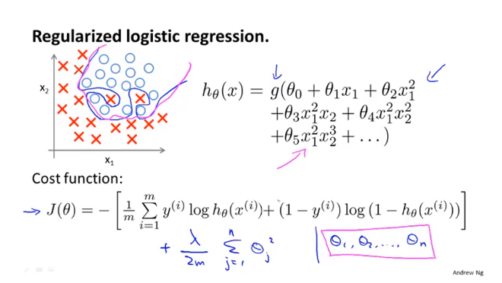
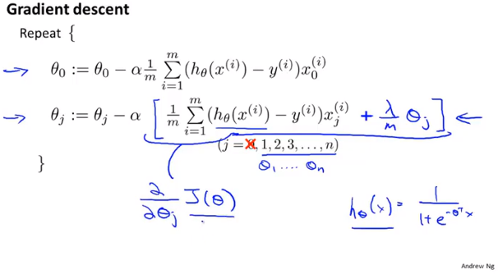
Chapter 8
Gradient Decent for regularized linear regression

Slide 17
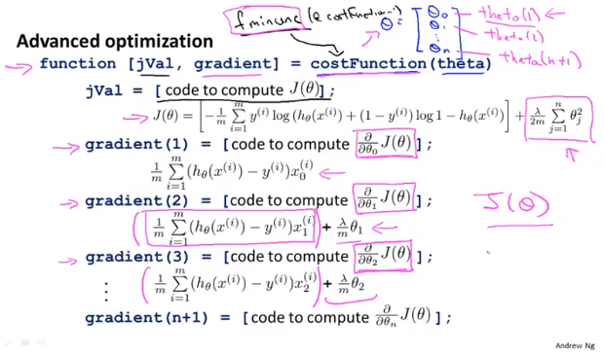
Chapter 8

